Slide 1
Biópsia Líquida: Conceitos e aplicações
Mariana Petaccia de Macedo
Patologia Molecular - Rede D’Or
Congresso Brasileiro de Patologia
Belém – Pará - Maio 2024

Slide 2
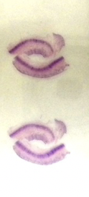
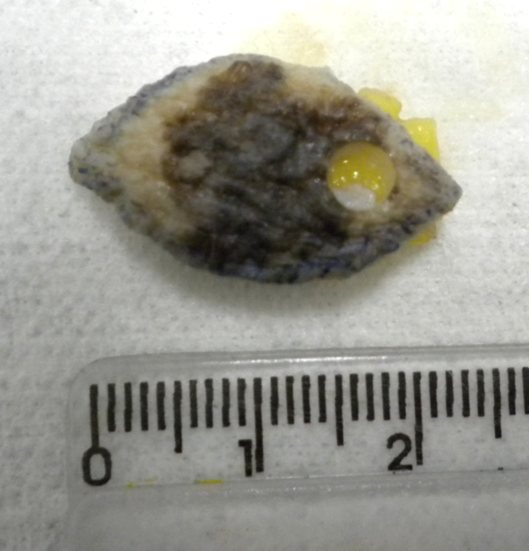
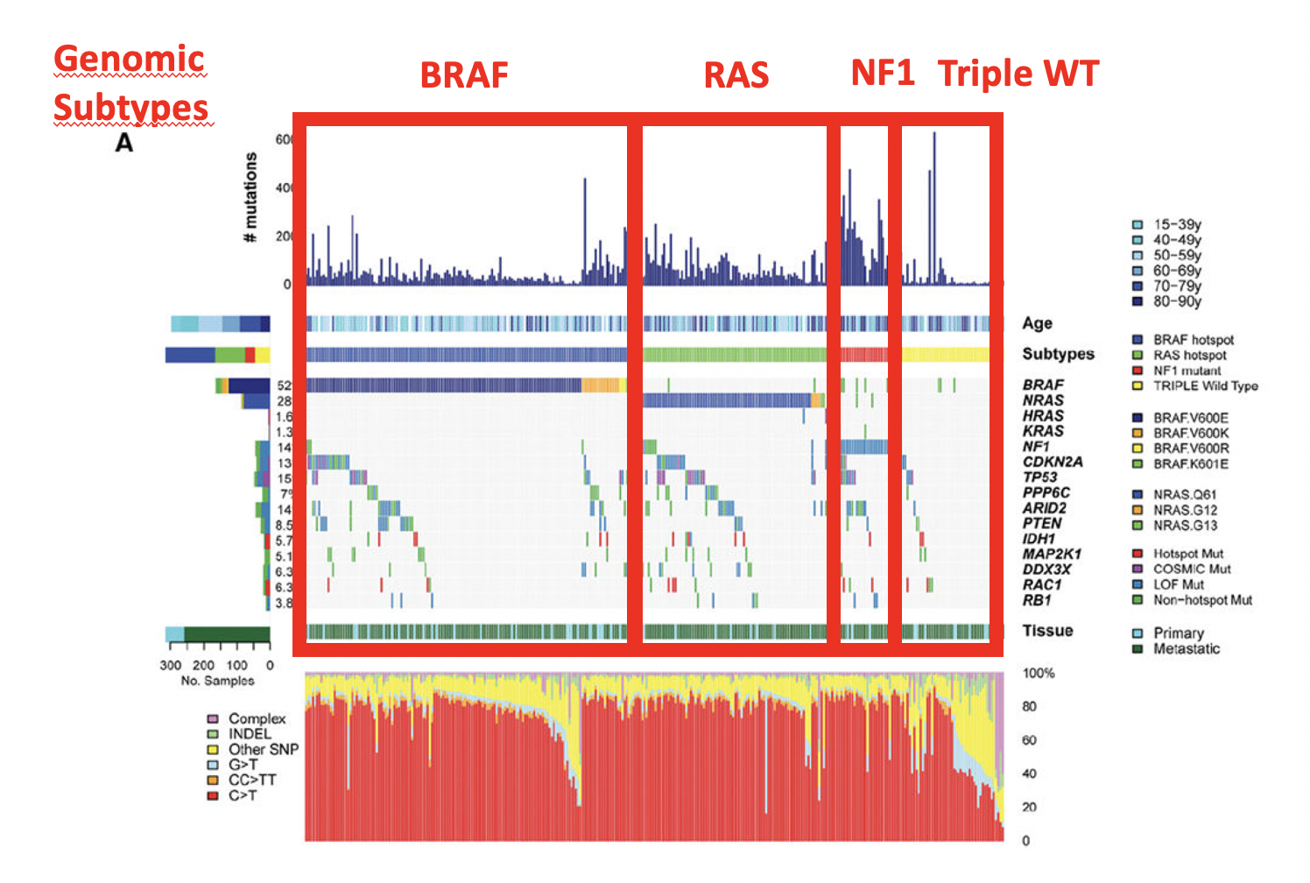
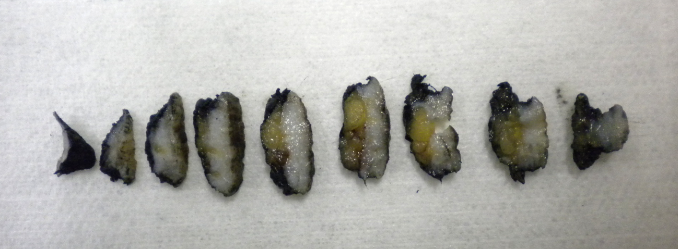
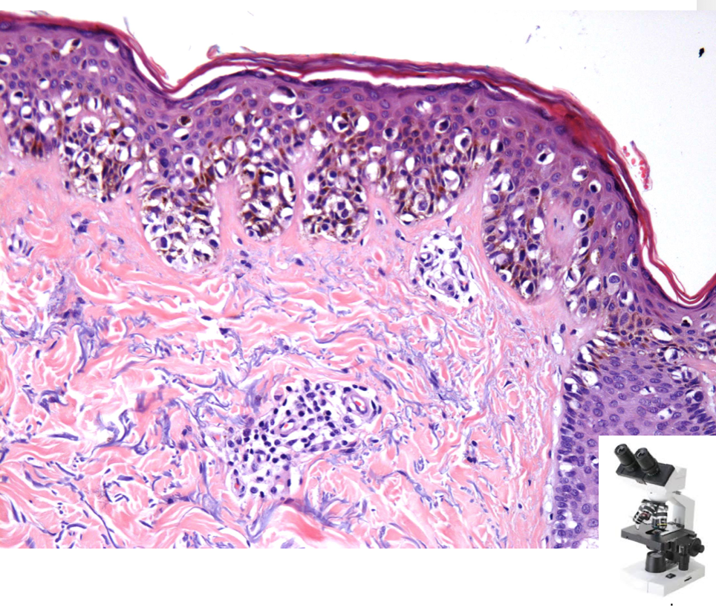
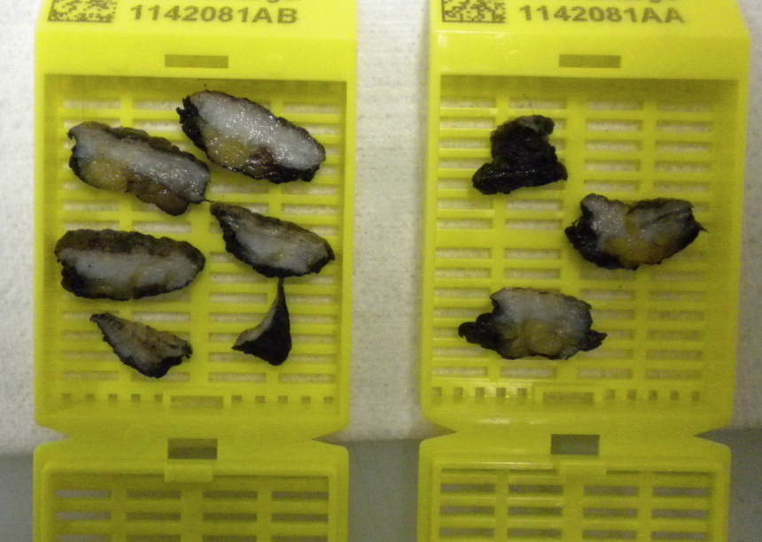
TISSUE BASED MOLECULAR PATHOLOGY
Notes:
De formaa tradicioal para o patologista o estudo o melanoma comeca com a retirada de uma lesao , seja primaria ou uma biopsia ou resseccao cirurgica de uma metastase. Essse material então é manejado no lab de patologia, com a a realizacao dos estudos macroscopiocs, realizaxao de, cortes e representacao histologica, processamento histologico , comfeccao do bloco de parafina e lamina de H&E que permite o patologista ao microscopia fazer ofiagnositco da doenca e especificar os criterios microscopios porgnosticos importantes para o paciente. Desse bloco de parafina entao podemos fazer extração de moleculas como dna para estudo genotico dessas neoplasias.

Slide 3
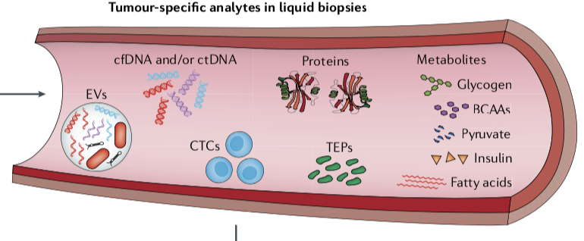
Liquid Biopsy
Analyze Biomarker from biological fluid
(blood, saliva or urine)
Notes:
Diferente da analise molecular baseada em tecido, Já a bioopsia liquida é um ametodologia que permite analisar biomarcadores a partir de fluidos corporais como sangue, saliva e urina.
Sabemos que nos fluidos biologicos, e aqui representado um vaso sanguineo e os componente do sangue, temos varias moleculaas como metabolites, proteinas, plaquetas, ceclulas tumorais circulantes, vesiculas extracelulares e fragmentos livres de material genetico como o DNA. Essas moleculas tem o otenciais de ser tornar biomarcadores na oncoloiga.

Slide 4
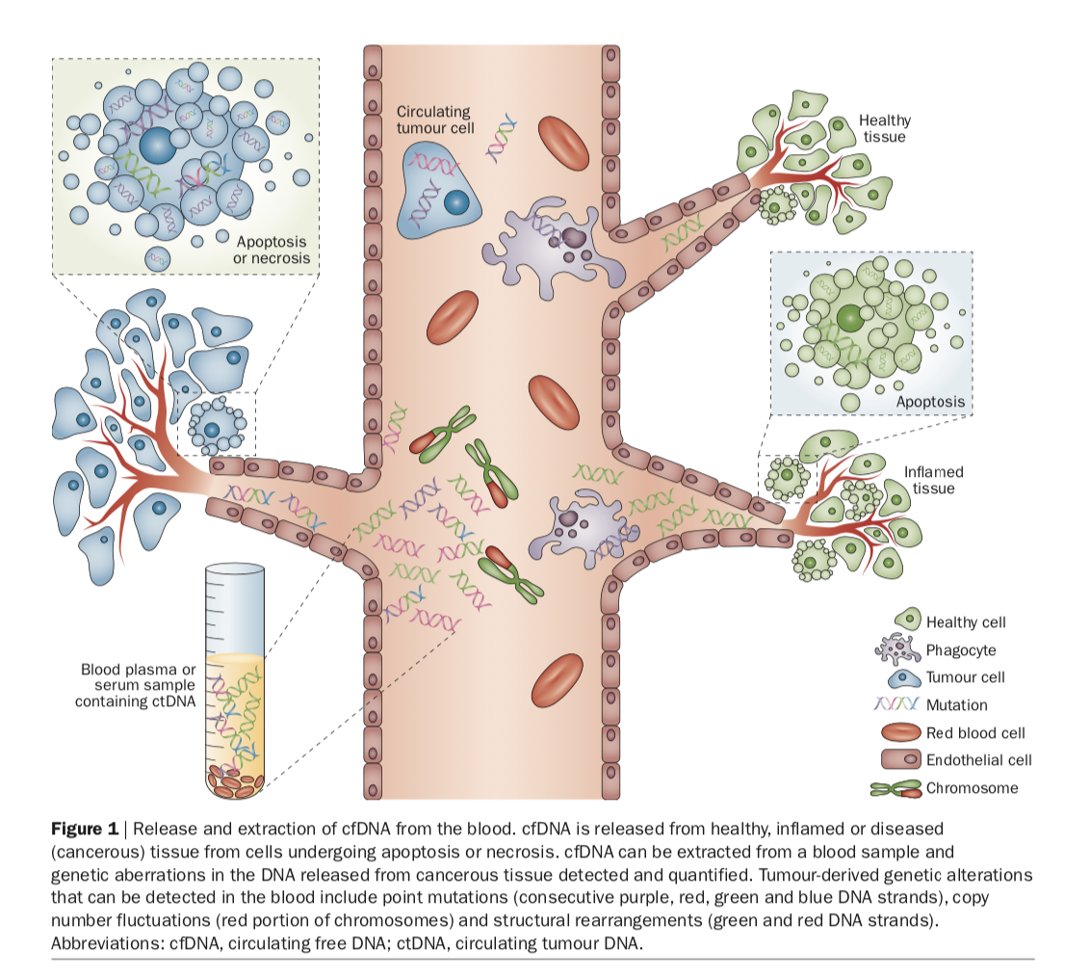
Non Neoplastic
ctDNA
Liquid Biopsy
Analyze Biomarker from biological fluid
(blood, saliva or urine)

Slide 5
Non Neoplastic
ctDNA
Circulationg tumor DNA (cell free tumor DNA)
Liquid Biopsy
Analyze Biomarker from biological fluid
(blood, saliva or urine)

Slide 6
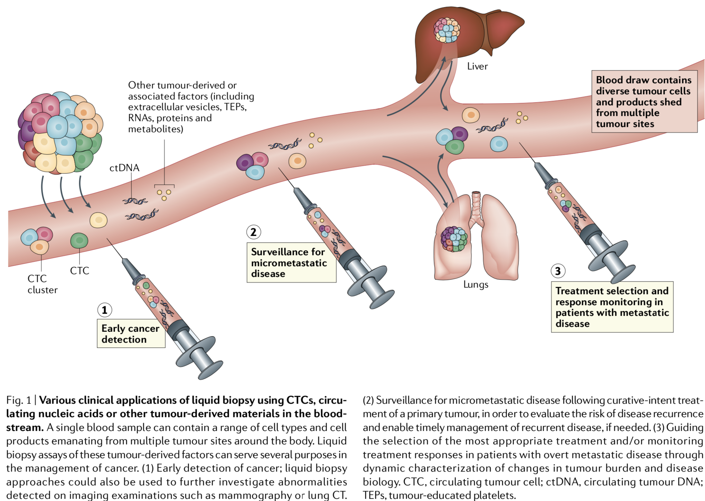
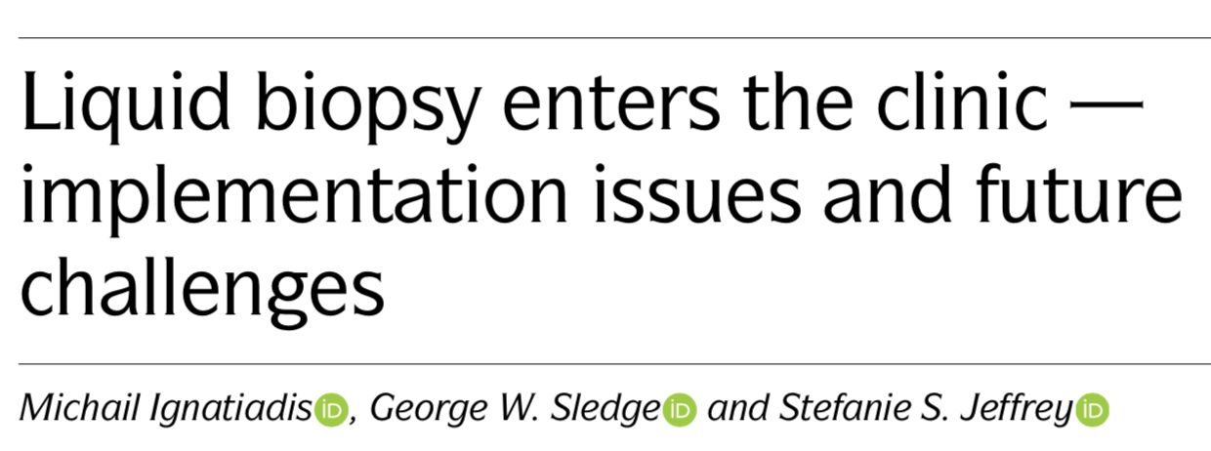
Applications of liquid biopsy (ctDNA)
Notes:
EALRY DETECTION –
Usar biopsia liquida como screening populacionaisl atraves de deteccao combinada de mutacoes e proteinas. Dois problemas: baixa quantidade desses marcadores em doenca inicial e baixa incidencia de cancer na populacao geral.
Apesar de dados interessanres e potencial promissor e uma grande esperaça de ser utilizaco como screening, e considerando a baixa concentracao dos marcadores no sangue nos tumors em estadios muito inicias, osndados dos testes para detecao precoce são interessantes, mas ainda é necessário demonstrar melhoria de desfecho clinic atraves de estudos clinicos.
Technologyisaheadofclinicalpractice What is needed for large-scale clinical validation? What would a positive result mean in screening scenario? Where is primary tumor located in screening scenario? How would one integrate liquid biopsies with other diagnostic methods? How would one treat a detected cancer? How would one prevent over-diagnosis and ensure cost-effectiveness?
“já que da maneira como os estudos foram feitos, já que a maioris dos tumors foi detectado por outros meios de screening e que a maior parte dos tumors foram disgnosticas em estadio avancado por essas tenicas.
“These results, while interesting, arguably indicate that this particular approach is likely to have limited clinical utility, given that most cancers were detected by other means and that 17 of the 26 (65%) cancers detected by the blood test were diagnosed at an advanced stage. Thus, further refinement of this test is ongoing. Whether this approach would improve clinical outcomes in an unselected population remains unknown in the absence of a randomized controlled trial.

Slide 7
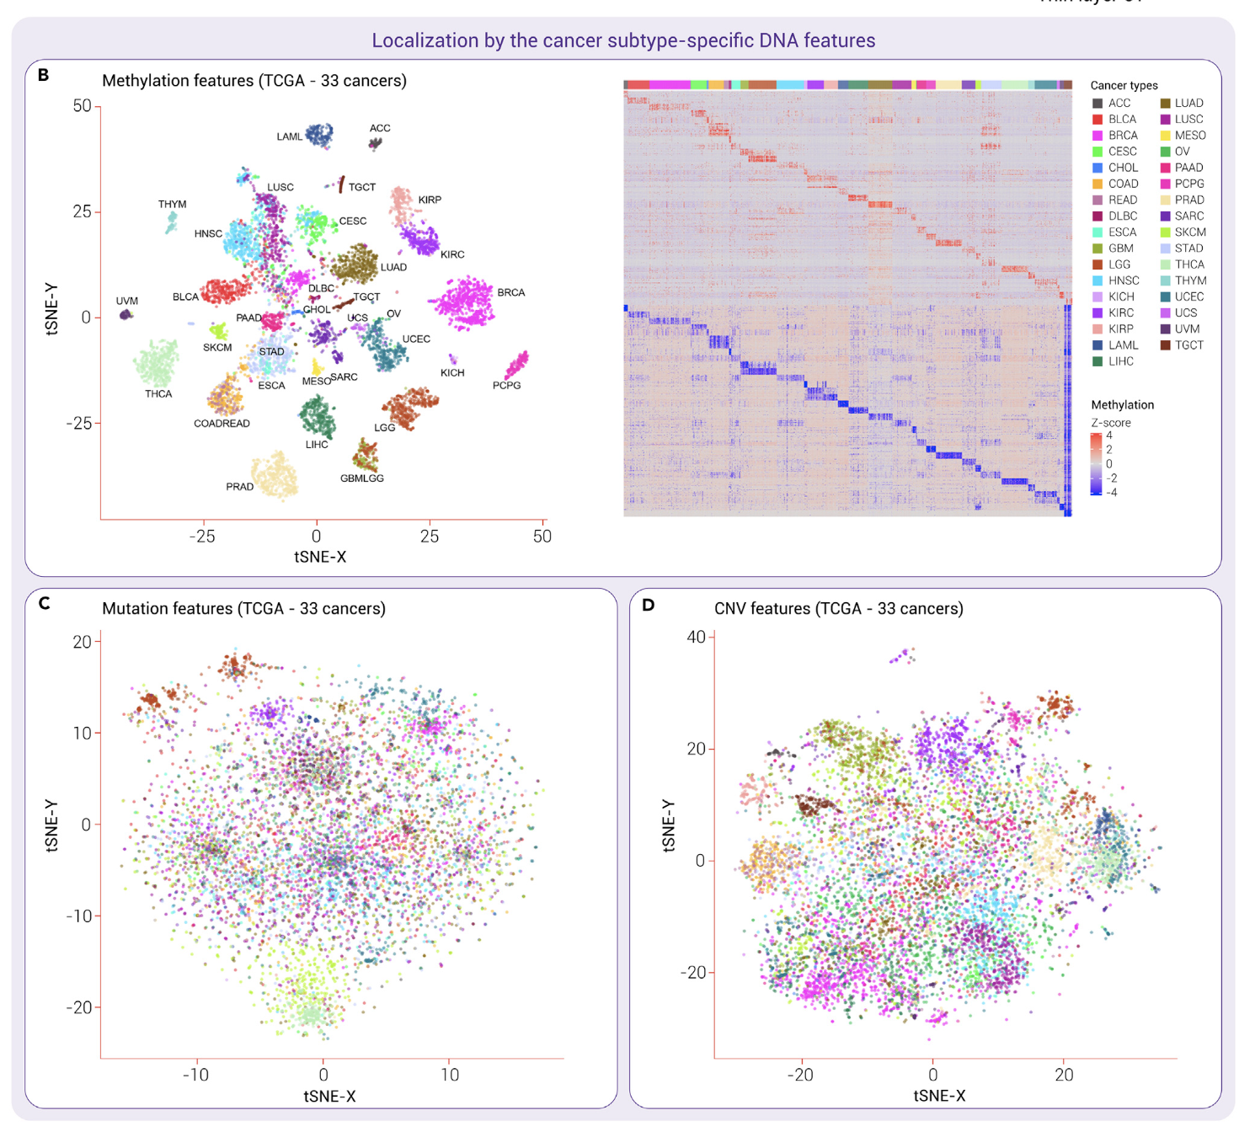
Applications of liquid biopsy (ctDNA)
Asymptomatic population
Screening
Improve early diagnosis and better intervention
*Asymptomatic individuals
Notes:
EALRY DETECTION –
Usar biopsia liquida como screening populacionaisl atraves de deteccao combinada de mutacoes e proteinas. Dois problemas: baixa quantidade desses marcadores em doenca inicial e baixa incidencia de cancer na populacao geral.
Apesar de dados interessanres e potencial promissor e uma grande esperaça de ser utilizaco como screening, e considerando a baixa concentracao dos marcadores no sangue nos tumors em estadios muito inicias, osndados dos testes para detecao precoce são interessantes, mas ainda é necessário demonstrar melhoria de desfecho clinic atraves de estudos clinicos.
Technologyisaheadofclinicalpractice What is needed for large-scale clinical validation? What would a positive result mean in screening scenario? Where is primary tumor located in screening scenario? How would one integrate liquid biopsies with other diagnostic methods? How would one treat a detected cancer? How would one prevent over-diagnosis and ensure cost-effectiveness?
“já que da maneira como os estudos foram feitos, já que a maioris dos tumors foi detectado por outros meios de screening e que a maior parte dos tumors foram disgnosticas em estadio avancado por essas tenicas.
“These results, while interesting, arguably indicate that this particular approach is likely to have limited clinical utility, given that most cancers were detected by other means and that 17 of the 26 (65%) cancers detected by the blood test were diagnosed at an advanced stage. Thus, further refinement of this test is ongoing. Whether this approach would improve clinical outcomes in an unselected population remains unknown in the absence of a randomized controlled trial.

Slide 8
Applications of liquid biopsy (ctDNA)
Micrometastatic disease / Residual
Risk of disease recurrence
Enable timely management of recurrent disease
Notes:
EALRY DETECTION –
Usar biopsia liquida como screening populacionaisl atraves de deteccao combinada de mutacoes e proteinas. Dois problemas: baixa quantidade desses marcadores em doenca inicial e baixa incidencia de cancer na populacao geral.
Apesar de dados interessanres e potencial promissor e uma grande esperaça de ser utilizaco como screening, e considerando a baixa concentracao dos marcadores no sangue nos tumors em estadios muito inicias, osndados dos testes para detecao precoce são interessantes, mas ainda é necessário demonstrar melhoria de desfecho clinic atraves de estudos clinicos.
Technologyisaheadofclinicalpractice What is needed for large-scale clinical validation? What would a positive result mean in screening scenario? Where is primary tumor located in screening scenario? How would one integrate liquid biopsies with other diagnostic methods? How would one treat a detected cancer? How would one prevent over-diagnosis and ensure cost-effectiveness?
“já que da maneira como os estudos foram feitos, já que a maioris dos tumors foi detectado por outros meios de screening e que a maior parte dos tumors foram disgnosticas em estadio avancado por essas tenicas.
“These results, while interesting, arguably indicate that this particular approach is likely to have limited clinical utility, given that most cancers were detected by other means and that 17 of the 26 (65%) cancers detected by the blood test were diagnosed at an advanced stage. Thus, further refinement of this test is ongoing. Whether this approach would improve clinical outcomes in an unselected population remains unknown in the absence of a randomized controlled trial.

Slide 9
Applications of liquid biopsy (ctDNA)
ctDNA in advanced-stage disease
Treatment selection
Detection of genomic alterations w/ druggable targets
- Detection of resistance mechanisms (eg. Lung and CRC)
Monitoring of treatment efficacy
Notes:
EALRY DETECTION –
Usar biopsia liquida como screening populacionaisl atraves de deteccao combinada de mutacoes e proteinas. Dois problemas: baixa quantidade desses marcadores em doenca inicial e baixa incidencia de cancer na populacao geral.
Apesar de dados interessanres e potencial promissor e uma grande esperaça de ser utilizaco como screening, e considerando a baixa concentracao dos marcadores no sangue nos tumors em estadios muito inicias, osndados dos testes para detecao precoce são interessantes, mas ainda é necessário demonstrar melhoria de desfecho clinic atraves de estudos clinicos.
Technologyisaheadofclinicalpractice What is needed for large-scale clinical validation? What would a positive result mean in screening scenario? Where is primary tumor located in screening scenario? How would one integrate liquid biopsies with other diagnostic methods? How would one treat a detected cancer? How would one prevent over-diagnosis and ensure cost-effectiveness?
“já que da maneira como os estudos foram feitos, já que a maioris dos tumors foi detectado por outros meios de screening e que a maior parte dos tumors foram disgnosticas em estadio avancado por essas tenicas.
“These results, while interesting, arguably indicate that this particular approach is likely to have limited clinical utility, given that most cancers were detected by other means and that 17 of the 26 (65%) cancers detected by the blood test were diagnosed at an advanced stage. Thus, further refinement of this test is ongoing. Whether this approach would improve clinical outcomes in an unselected population remains unknown in the absence of a randomized controlled trial.

Slide 10
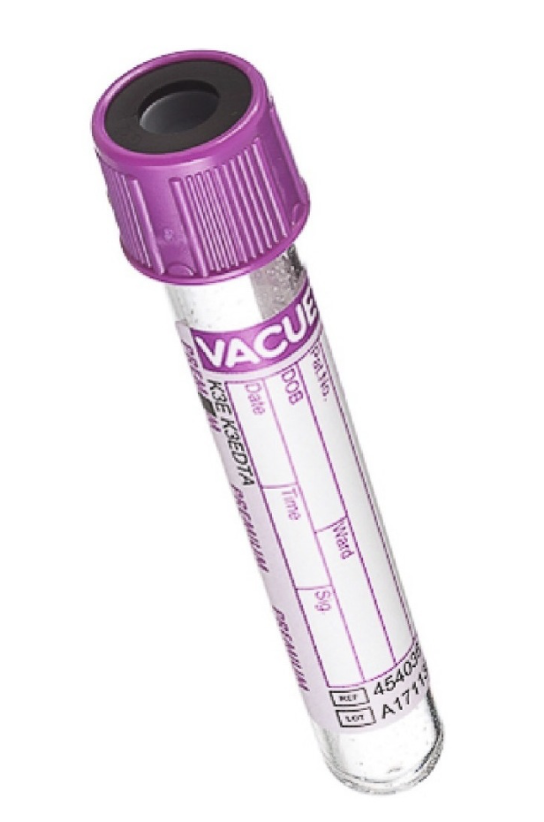
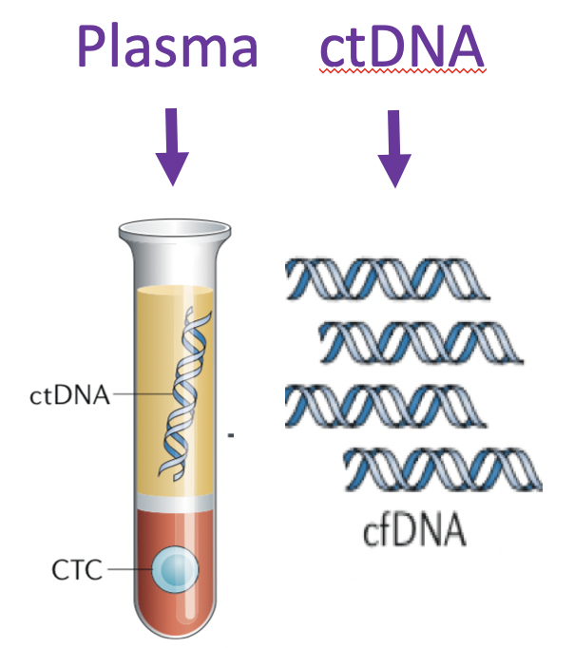
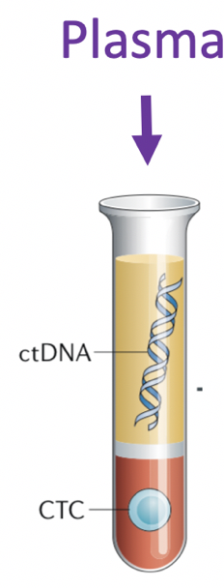
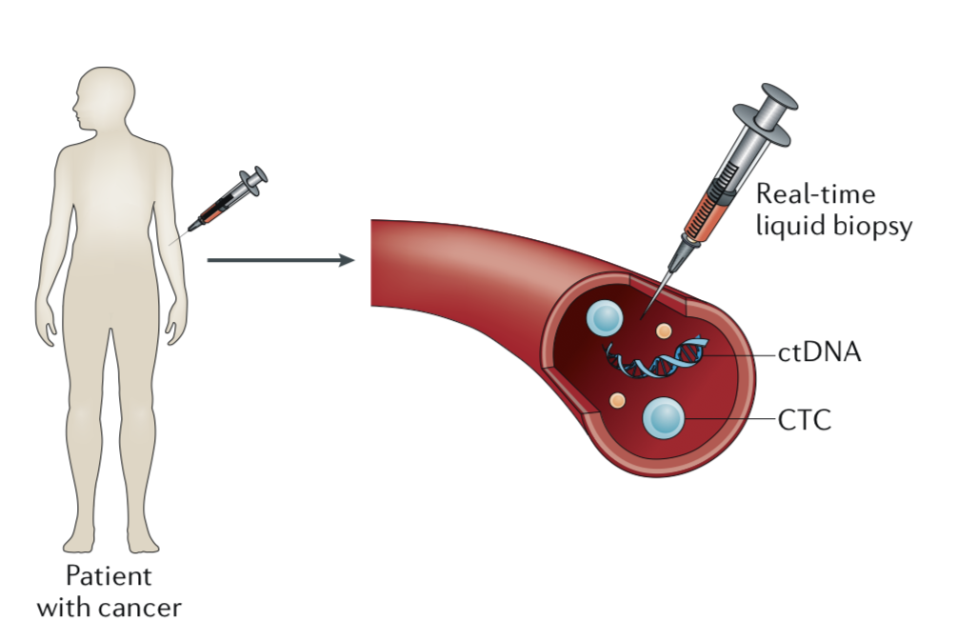
How to obtain ctDNA
EDTA tube
Few hours
cfDNA - short half-life
“real time”
Chalanges
Short interval to process sample
Special collection tube for the preservation of cell-free nucleic acids
Nucleic acid Preservative tube
Few days

Slide 11
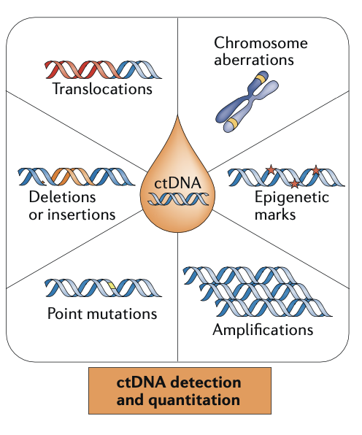
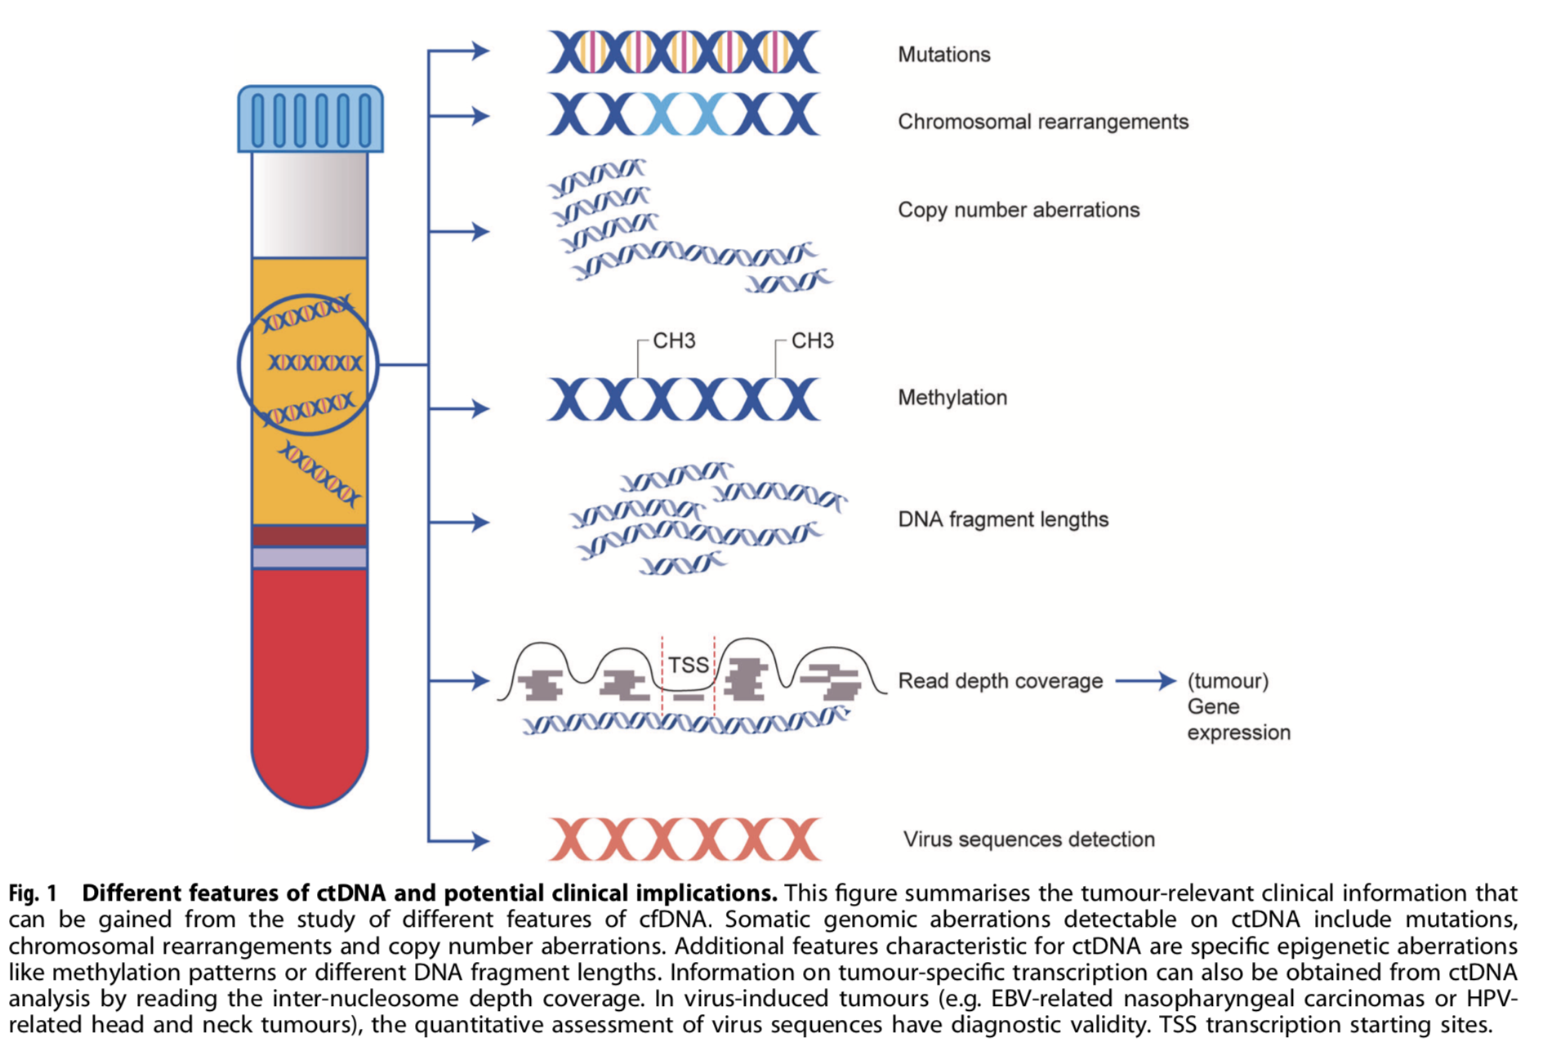
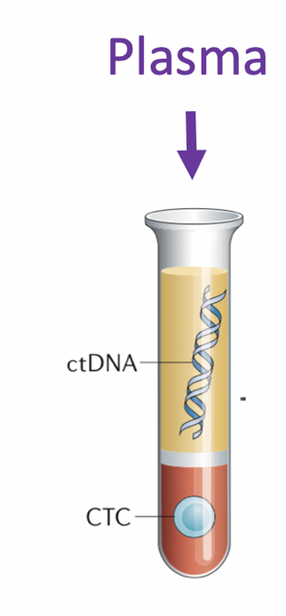
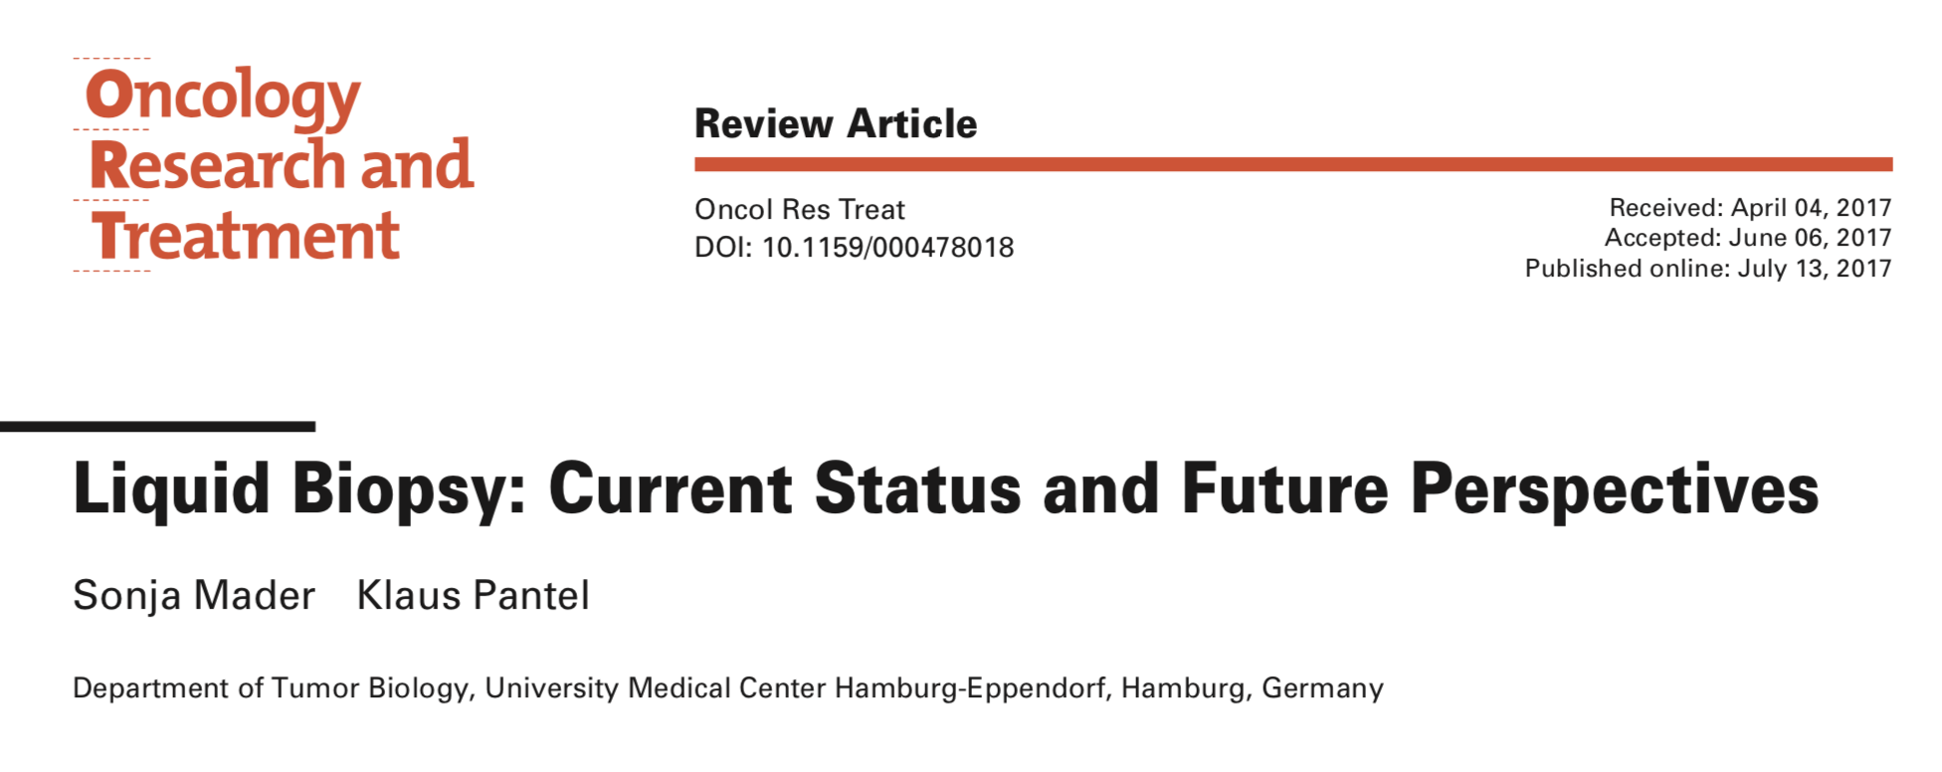
Notes:
- Normal cell-derived plasma DNA: 166bp
- ctDNA enriched for smaller fragments: 143-145bp

Slide 12
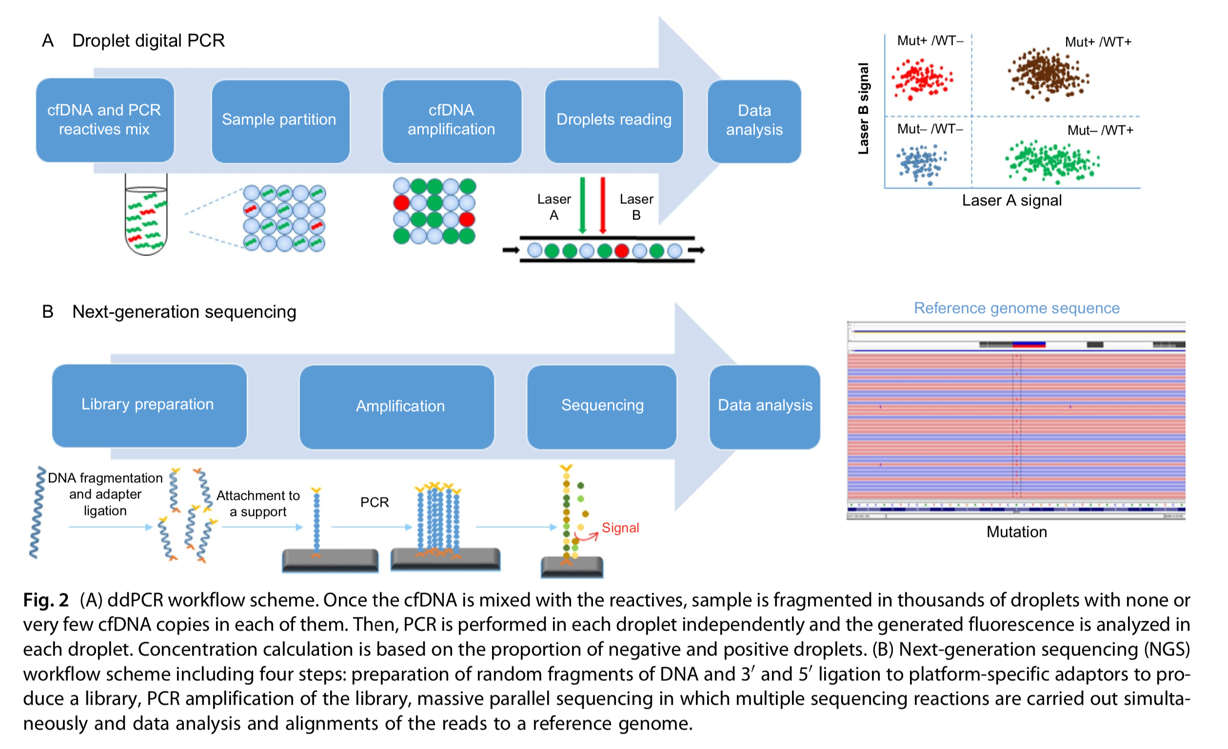
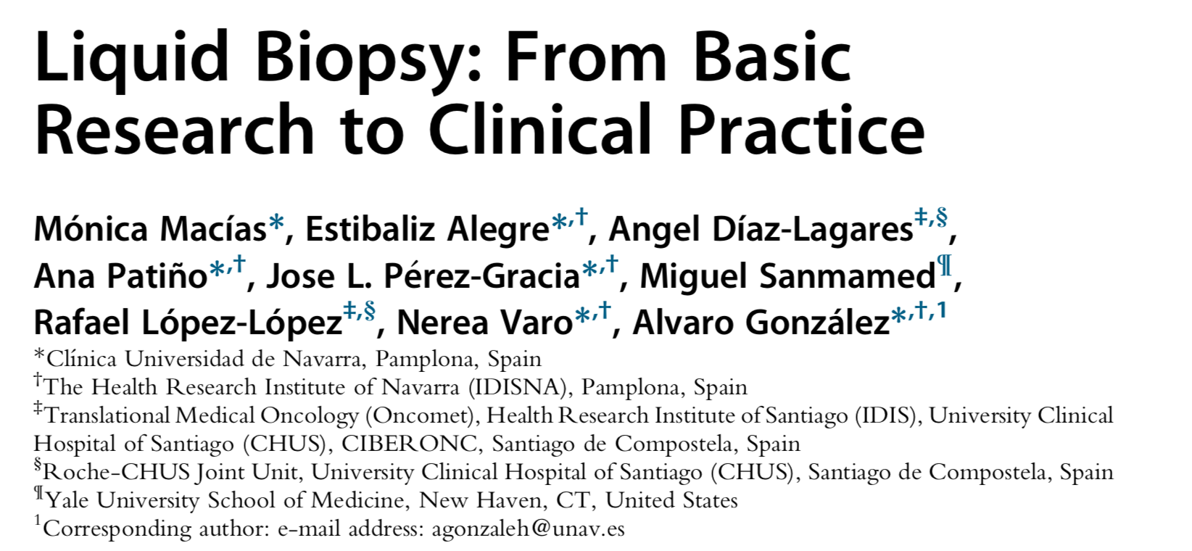
Approaches for cfDNA mutational analysis:
Highly sensitive techniques required:
- cfDNA concentrations in plasma are low
Mutation- targeted analysis
DNA sequencing > Gene Panel
Sensitive of 0,01%

Slide 13
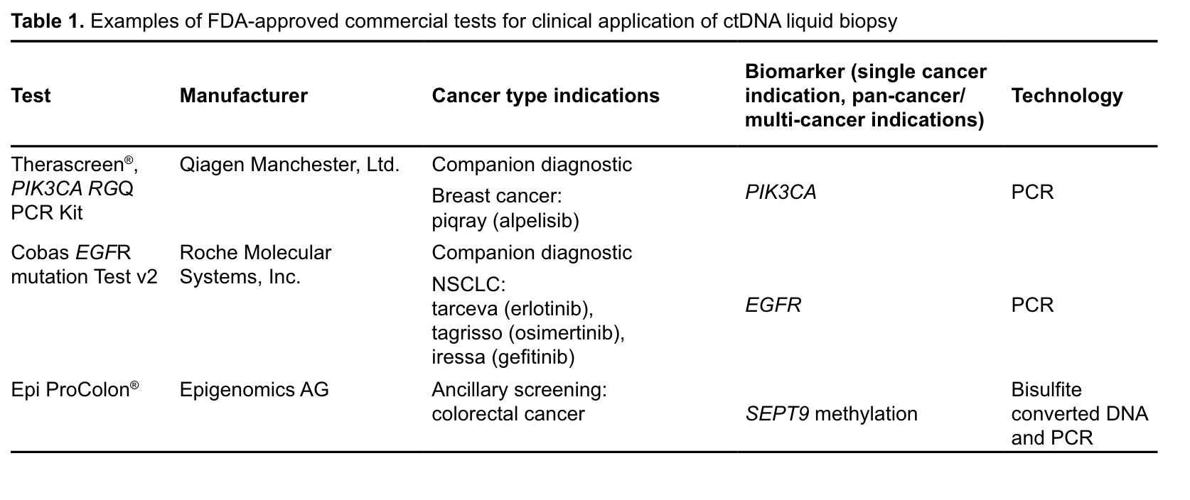
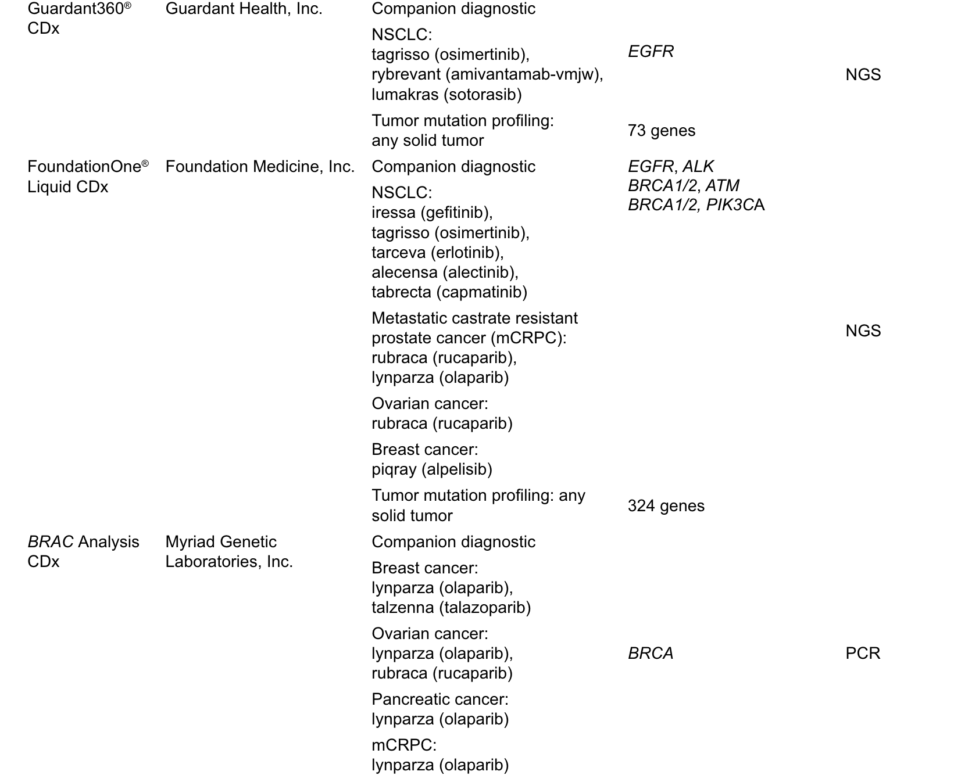
Examples of FDA-approved commercial tests for clinical application of ctDNA liquid biopsy
2023

Slide 14
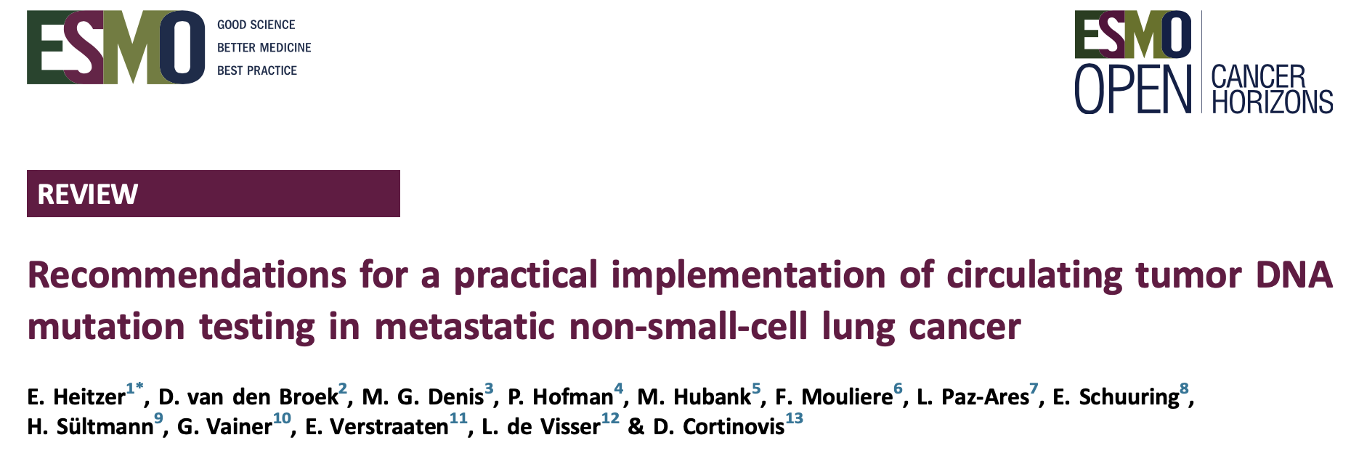
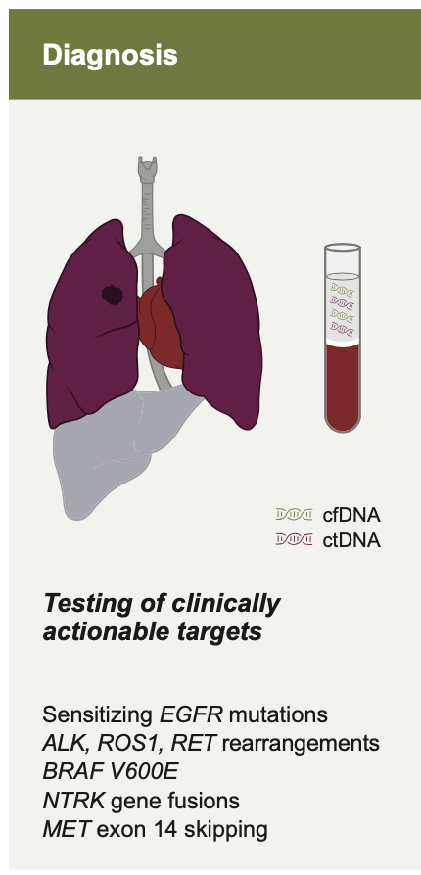
Applications of liquid biopsy (ctDNA)

Slide 15
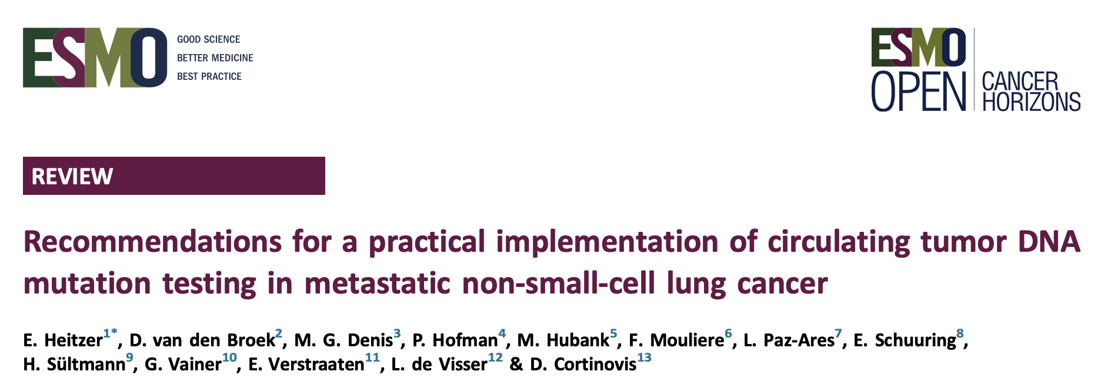
Patient scenarios for the use of ctDNA mutation testing in metastatic NSCLC
Dificuldade de Biópsia
Dificuldade de Biópsia
Or logistics
Quantidade
Qualidade
Logística

Slide 16
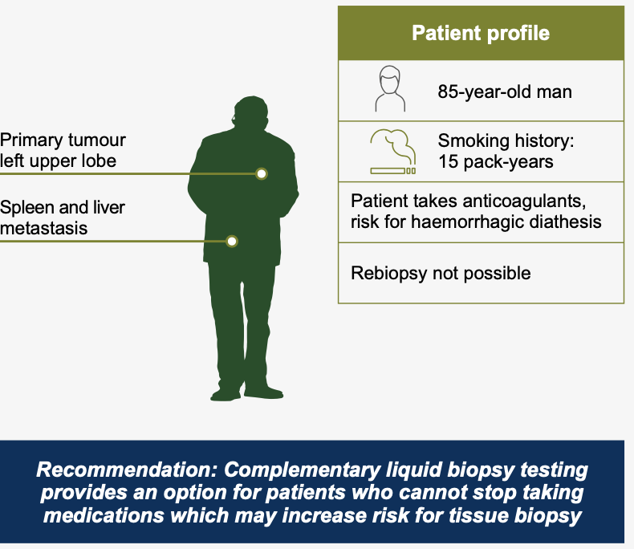
Patient scenarios for the use of ctDNA mutation testing in metastatic NSCLC
Dificuldade de Biópsia – questões do paciente

Slide 17
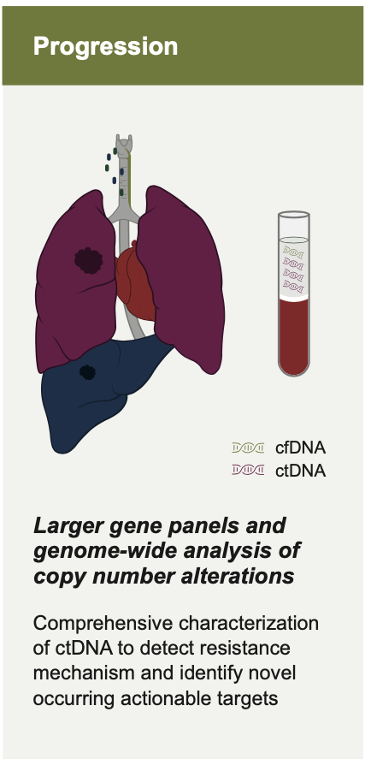
Applications of liquid biopsy (ctDNA) in NSCLC
Resistance Mechanisms
Plasma “first” approach

Slide 18
Applications of liquid biopsy (ctDNA)
Overall diagnostic sensitivity of LB (lung) (˜87%)
Limited detection on low tumor burden (early stage)
Limitation SNC / bone metastasis
Tissue analysis is essential when ctDNA negative

Slide 19
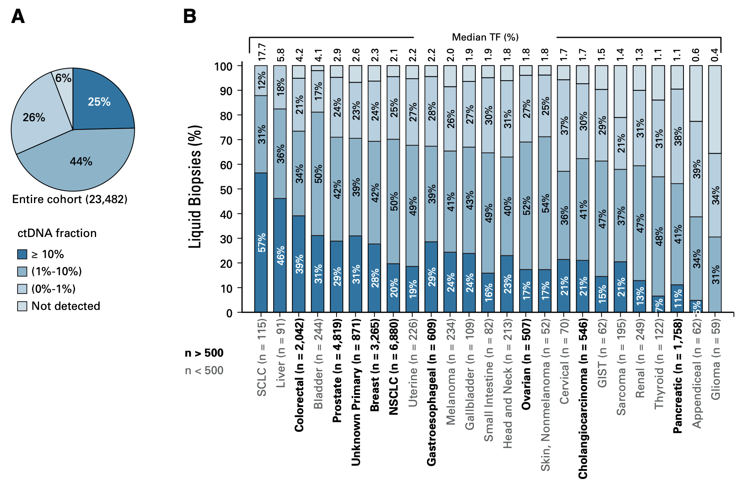
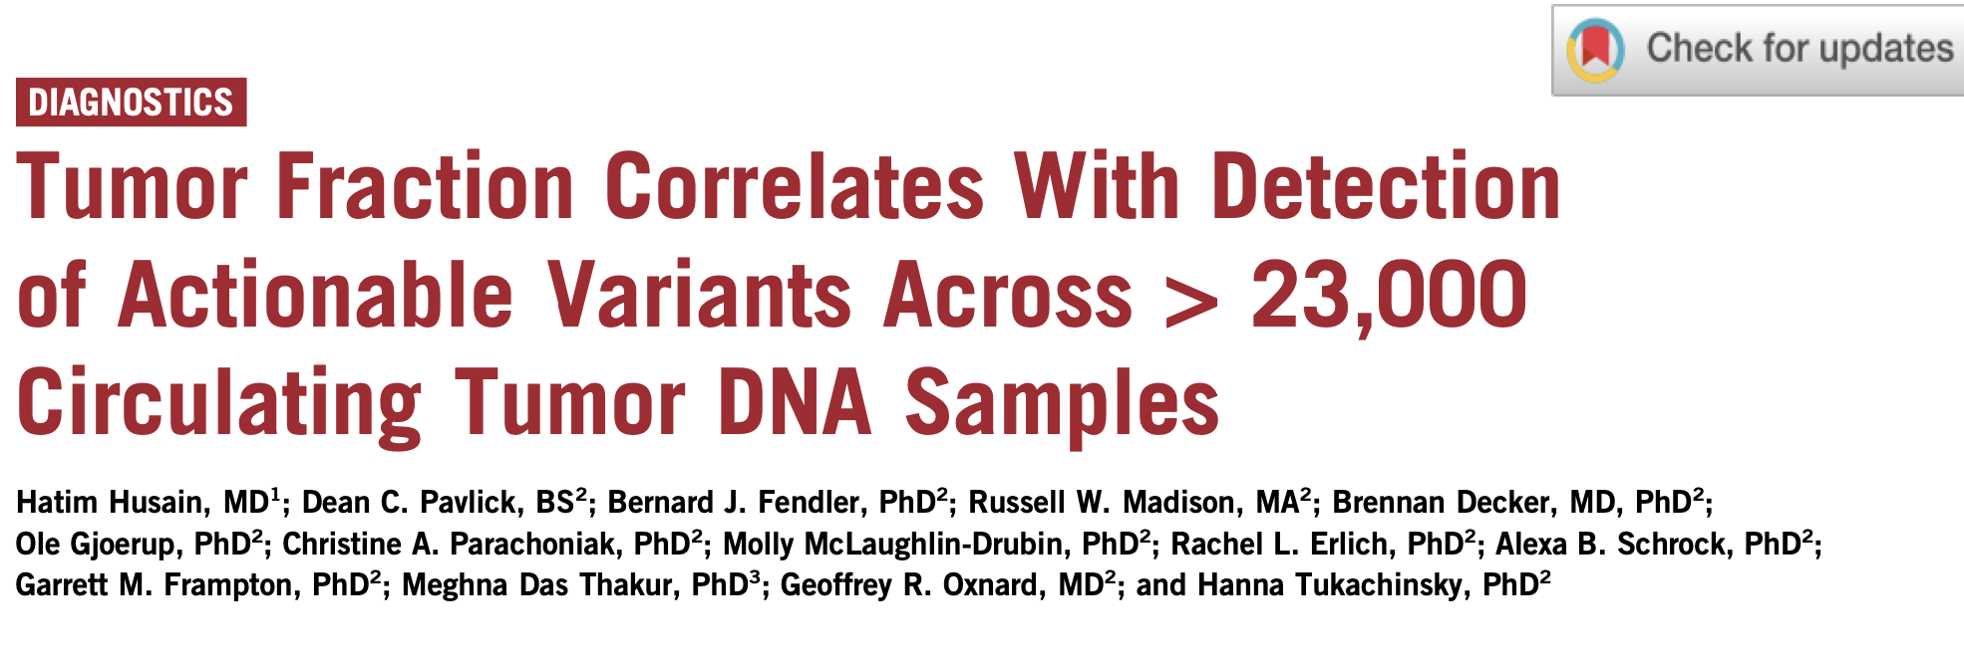
ctDNA levels change by tumor type
Results of 23,482 liquid biopsie, 25 solid tumor types from a 324 cancer-related genes panel
The sensitivity of LBx to detect driver alterations identified in tissue biopsy from the same patient ranged from 58% to 86% but was consistently at or near 100% in cases with TF ≥ 10%

Slide 20
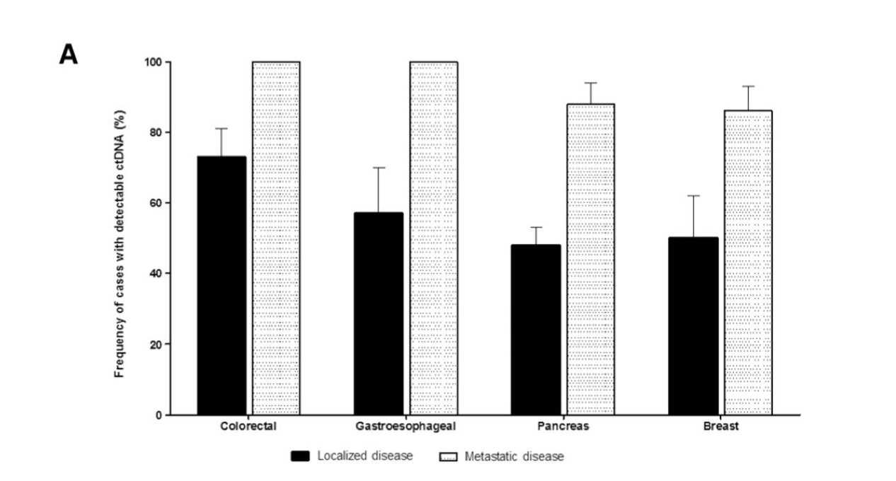
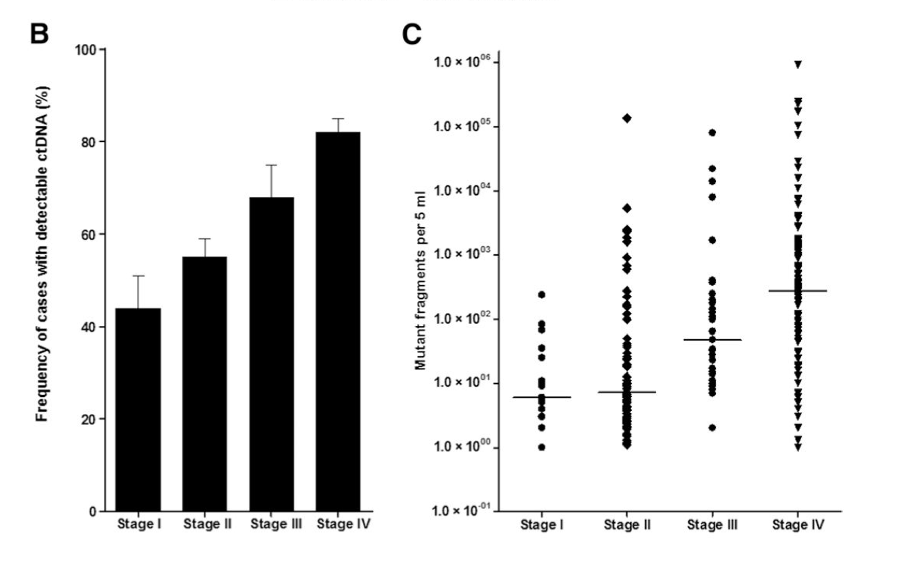
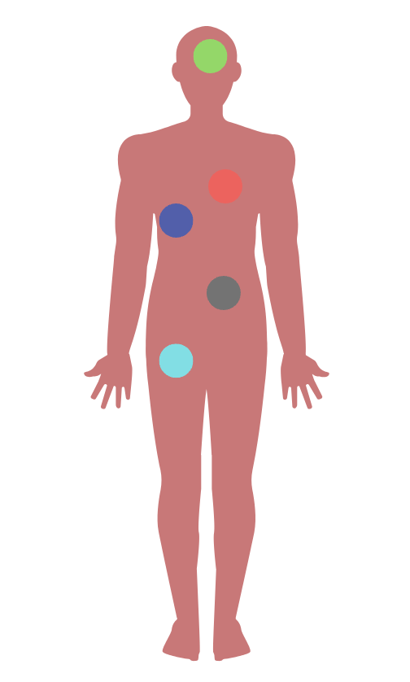
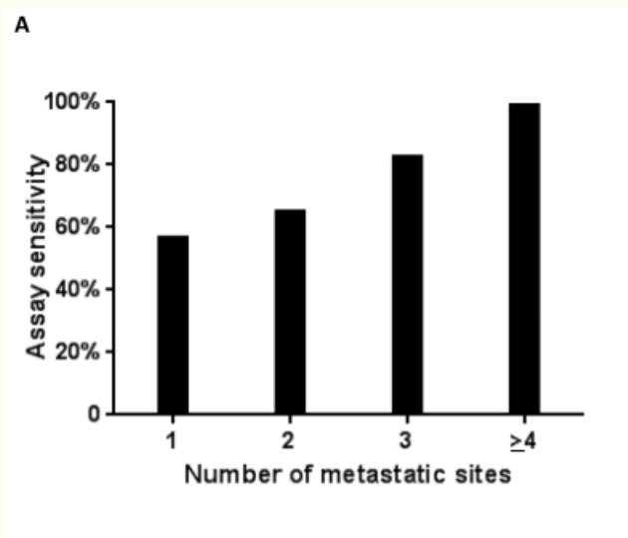
ctDNA correlates with stage and volume
Bettegowda et al. 2014, Sci Transl Med.
Sacher et al; JAMA 2016

Slide 21
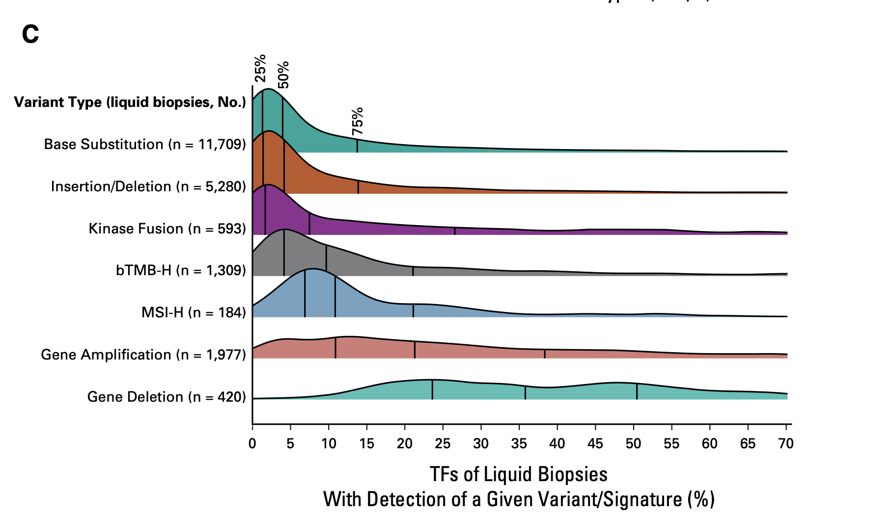
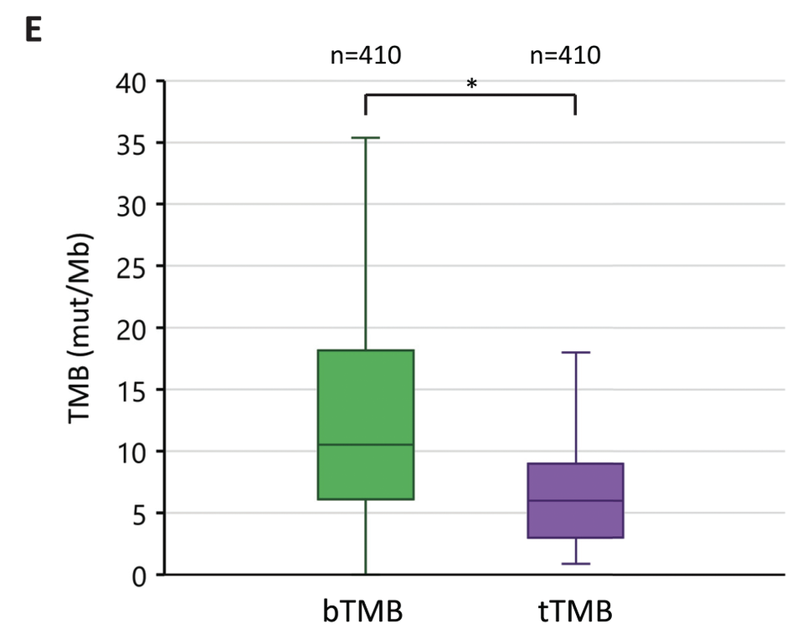
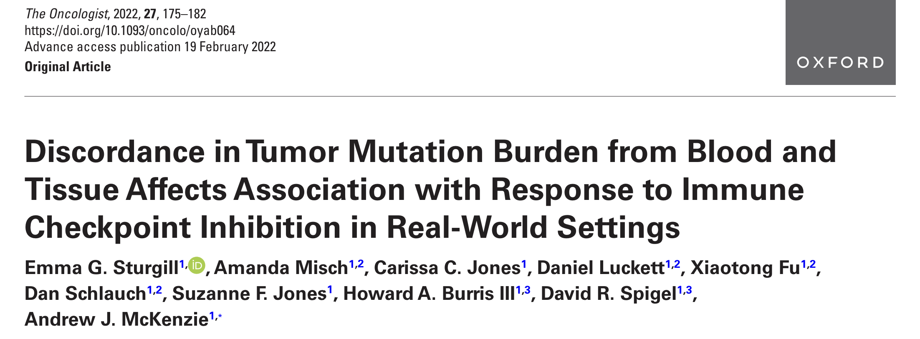

Slide 22
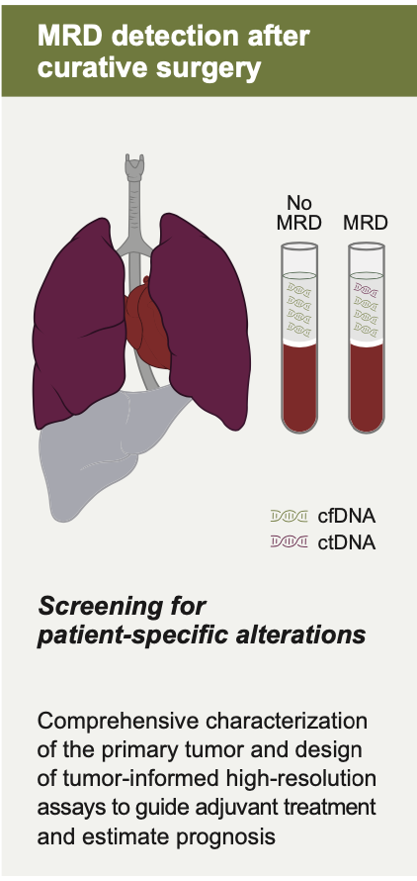
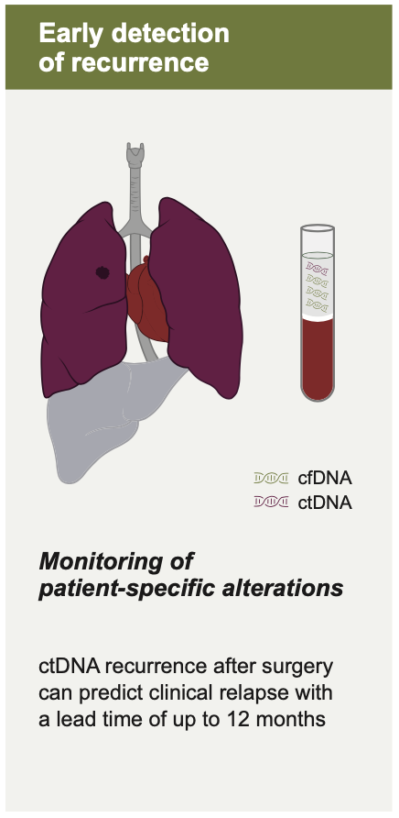
Applications of liquid biopsy (ctDNA) in NSCLC
Identify patients at higher risk of recurrence

Slide 23
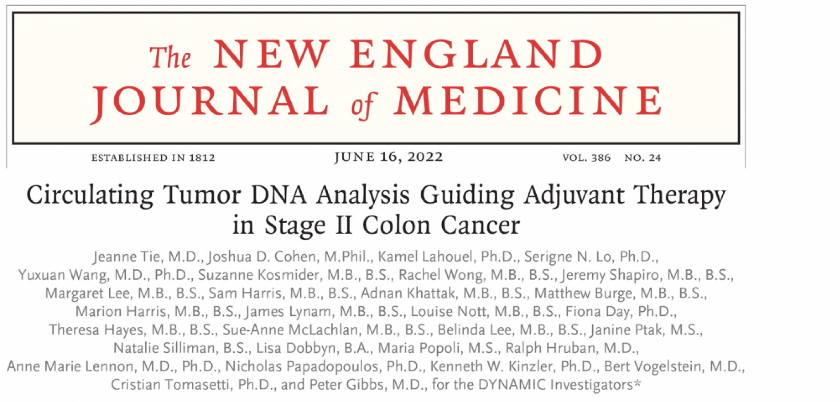
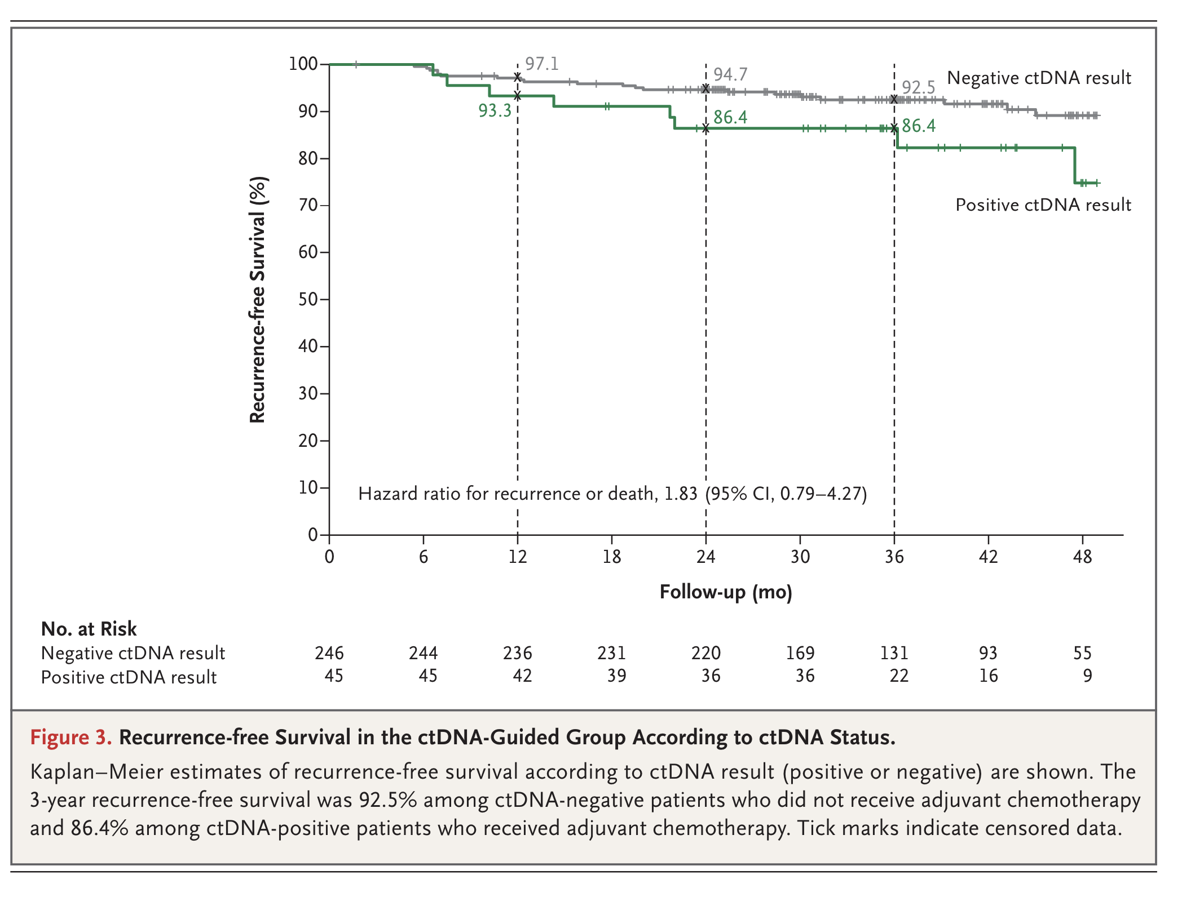
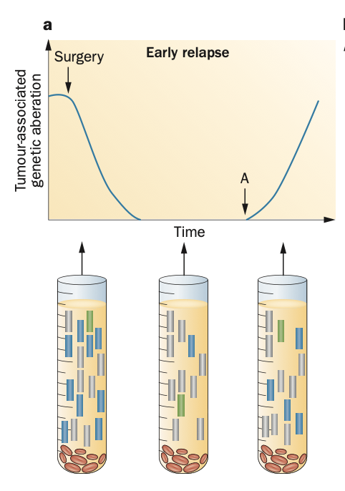
TUMOR INFORMED X PLASMA BASED TEST
Tissue characterization
Follow specific selected alterations

Slide 24
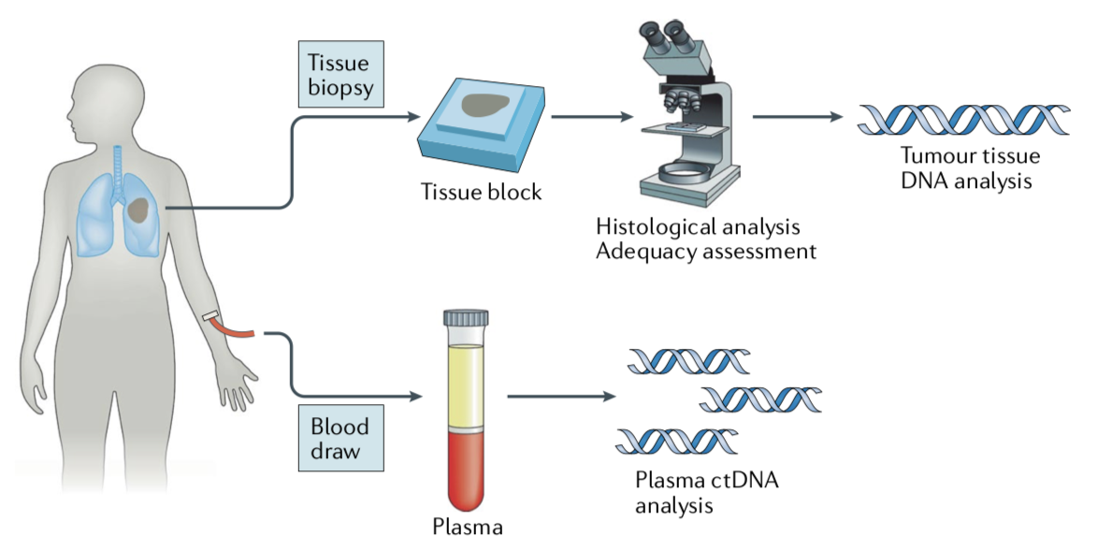
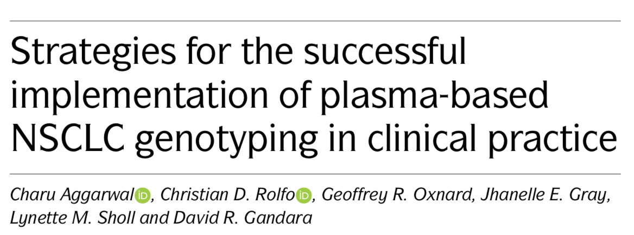
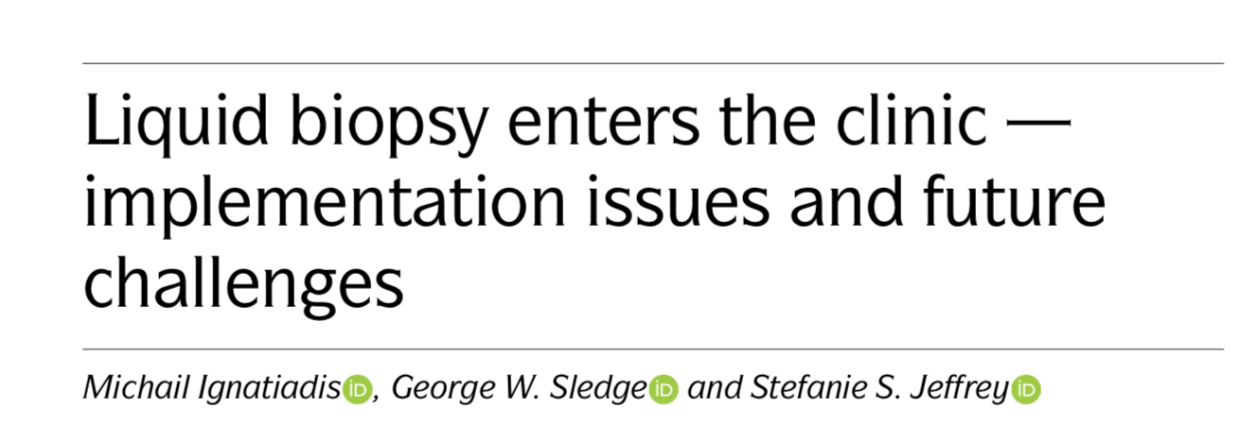
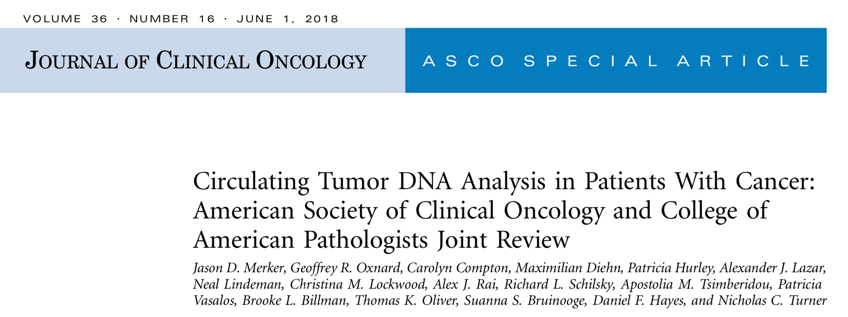
ctDNA
No correlation with morphology
Limited detection on low tumor burden (early stage)
Requires special processing - special tubes
Limitation SNC / bone metastasis
Sensitivity (risk for false negative)
Identification of genetic alteration with therapeutic benefits / resistance
Easy to obtain / Less invasive
Easy serial testing
Continuous monitoring of genetic alterations
More likely represent tumor heterogeneity
Faster result in some scenarios
Alternative to limited tissue available
Notes:
Vantagens e desvantagens

Slide 25
ctDNA
No correlation with morphology
Limited detection on low tumor burden (early stage)
Requires special processing - special tubes
Limitation SNC / bone metastasis
Sensitivity (risk for false negative)
Identification of genetic alteration with therapeutic benefits / resistance
Easy to obtain / Less invasive
Easy serial testing
Continuous monitoring of genetic alterations
More likely represent tumor heterogeneity
Faster result in some scenarios
Alternative to limited tissue available
Notes:
Vantagens e desvantagens

Slide 26
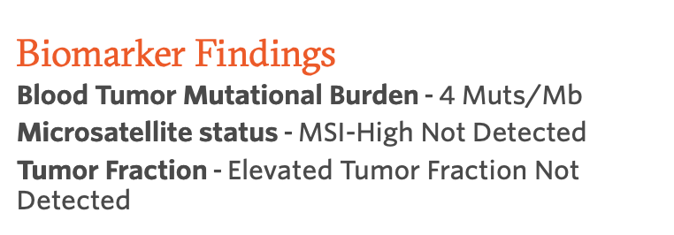
Decreasing the risk of false negative results from ctDNA
High sensitivity for identifying genomic alterations.
Elevated tumor fraction values
High ctDNA content
Cálculo:

Slide 27
ctDNA
No correlation with morphology
Limited detection on low tumor burden (early stage)
Requires special processing - special tubes
Limitation SNC / bone metastasis
Sensitivity (risk for false negative)
Identification of genetic alteration with therapeutic benefits / resistance
Easy to obtain / Less invasive
Easy serial testing
Continuous monitoring of genetic alterations
More likely represent tumor heterogeneity
Faster result in some scenarios
Alternative to limited tissue available
Risk of False positive
Notes:
Vantagens e desvantagens

Slide 28
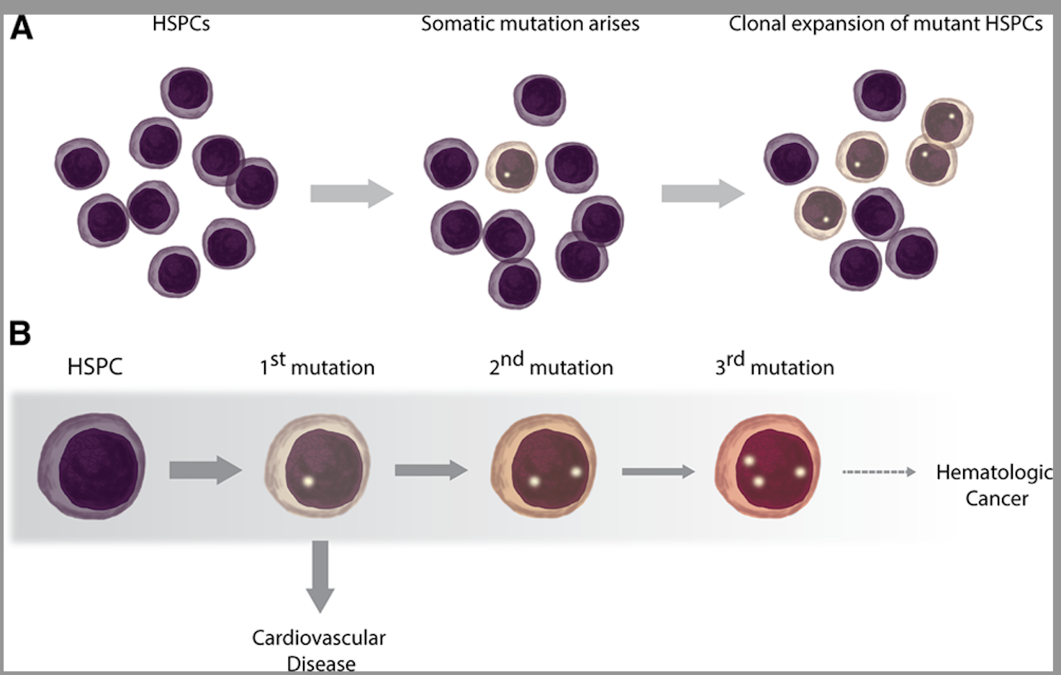
Hematopoyesis Clonal (CH)
Overrepresentation of blood cells derived from a single clone.
Accumulation of Somatic Mutations in Hematopoietic Stem/Progenitor Cells
Advantages of Selective Growth
Clonal expansions of hematopoietic cells
Heitzer E, Perakis S, Geigl JB, Speicher MR. The potential of liquid biopsies for the early detection of cancer. NPJ Precis Oncol. 2017 Oct 17;1(1):36.
Jaiswal S, Ebert BL. Clonal hematopoiesis in human aging and disease. Science. 2019 Nov 1;366(6465):eaan4673

Slide 29
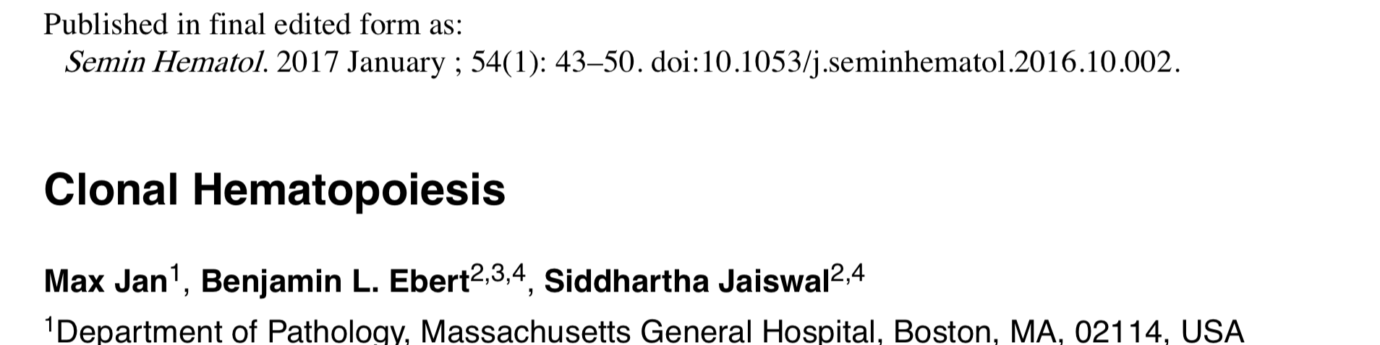
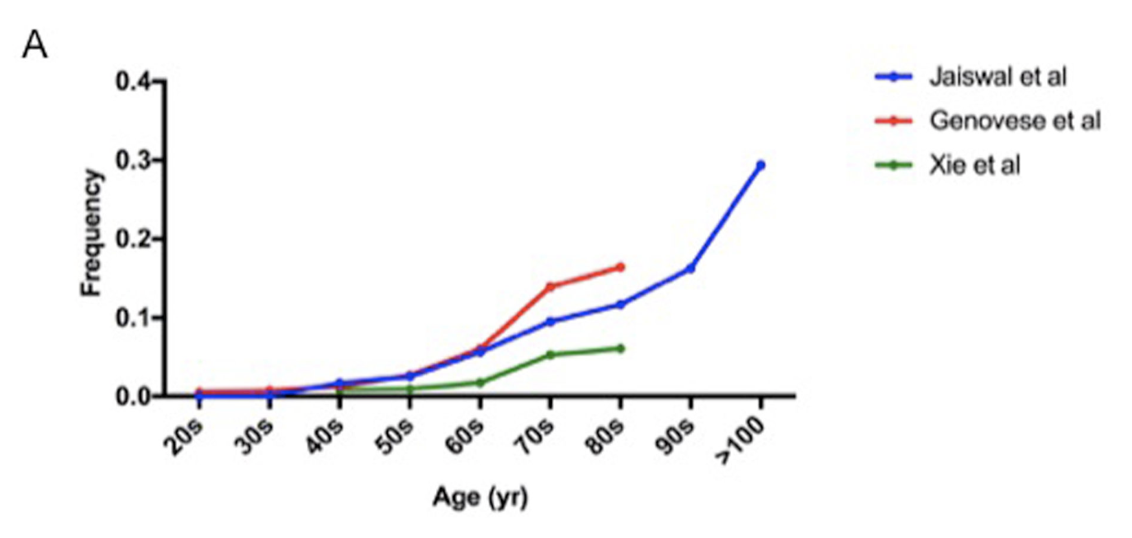
Age-related
Clonal Haematopoiesis
ARCH- no incluye definición sobre el tamaño de clon necesario
Prevalencia estimada de CH en función de la edad varía según el método de secuenciación
Jaiswal S, Ebert BE. Clonal hematopoiesis in human aging and disease. Science. 2019;366(6465):eaan4673.
Jaiswal S, Libby P. Clonal haematopoiesis: connecting ageing and inflammation in cardiovascular disease. Nat Rev Cardiol. 2020 Mar;17(3):137-144
Chan HT et al. Clonal Hematopoiesis in Liquid Biopsy: From Biological Noise to Valuable Clinical Implications. Cancers (Basel). 2020 Aug 14;12(8):22777

Slide 30
Clonal Hematopoiesis and cfDNA in Liquid Biopsy
CH may account for the non-tumor derived mutations detected from plasma
Incorrect classification of mutations detected in cfDNA as tumor mutations could > inappropriate therapeutic decisions
Heitzer E et al. Nat Rev Genet. 2019 Feb;20(2):71-88.
Crowley E, et al. Nat Rev Clin Oncol. 2013 Aug;10(8):472-84

Slide 31
CH mutations can contribute greatly to the mutations detected from liquid biopsy
Possibilidade:
Paired cfDNA and blood sequencing
Slide da apresentadora.
Notes:
A total of 5–15% of TP53 mutations detected in the plasma cfDNA of lung cancer patients were also detected in white blood cells, suggesting their CH origin. These early observations were validated in a recent prospective study that performed deep sequencing of cfDNA and matched white blood cells over 124 patients with metastatic cancer using a large gene panel (508 genes)

Slide 33
Obrigada!!
Mariana.petaccia@rededor.com.br

Slide 34
Hematopoyesis clonal de potencial indeterminado (CHIP)
- Clinical entity: cancer-associated clonal mutation in the blood cells of a person without a frank malignancy or another recognized clonal entity
Clinical Impact
Increased risk of cardiovascular diseases such as atherosclerosis, myocardial infarction, and thrombosis.
Heitzer E, Perakis S, Geigl JB, Speicher MR. The potential of liquid biopsies for the early detection of cancer. NPJ Precis Oncol. 2017 Oct 17;1(1):36.
Jaiswal S, Ebert BL. Clonal hematopoiesis in human aging and disease. Science. 2019 Nov 1;366(6465):eaan4673

